Slide 1
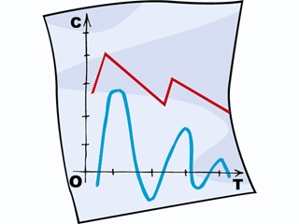

Graphing:
Let’s Organize the Data!
We will cover:
Data Tables
Line Graphs
Bar Graphs
Circle Graphs

Slide 2
Introduction
Whenever data is collected, it is often presented in a meaningful way so that others can view and make sense of it.
Often the data will be presented in a _________ or a _____.
Data tables are a way of _________ the information.
Graphs are _______________ that represent ______________.
data table
graph
organizing
pictorial diagrams
numerical data

Slide 3
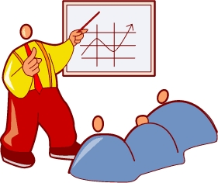
As a student, it is important that you master these essential skills:
1. Interpreting and reading graphs
2. Constructing data tables
Constructing different types of graphs (line graphs, bar graphs, circle graphs)
Critical thinking and problem solving

Slide 4
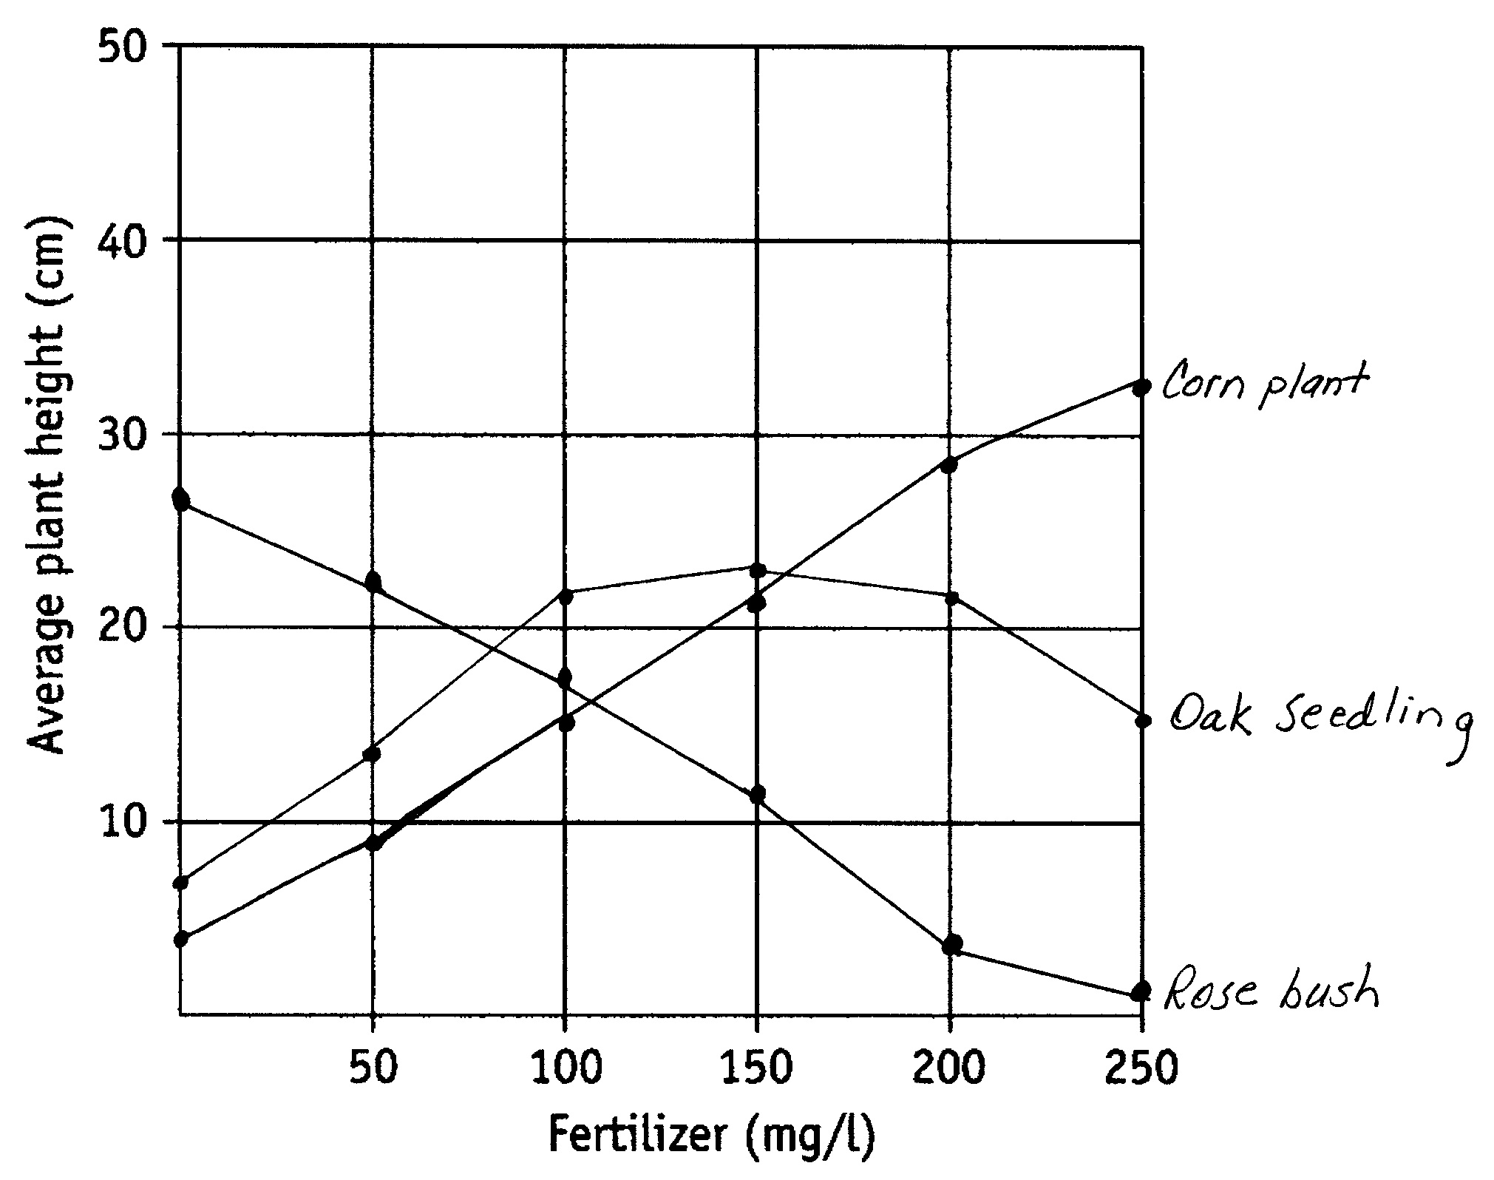
Interpreting Graphs
What information is being shown in this graph?
This graph shows the effect of different concentrations of fertilizer on the growth of three different types of plants.
Study the line graph and answer the following questions.

Slide 5
Describe the results shown for corn plants.
For corn plants, the higher the concentration of fertilizer, the taller the plants will grow.

Slide 6
Describe the results shown for oak seedlings.
As the concentration of fertilizer is increased, growth of oak seedlings is improved, up to a certain point.

Slide 7
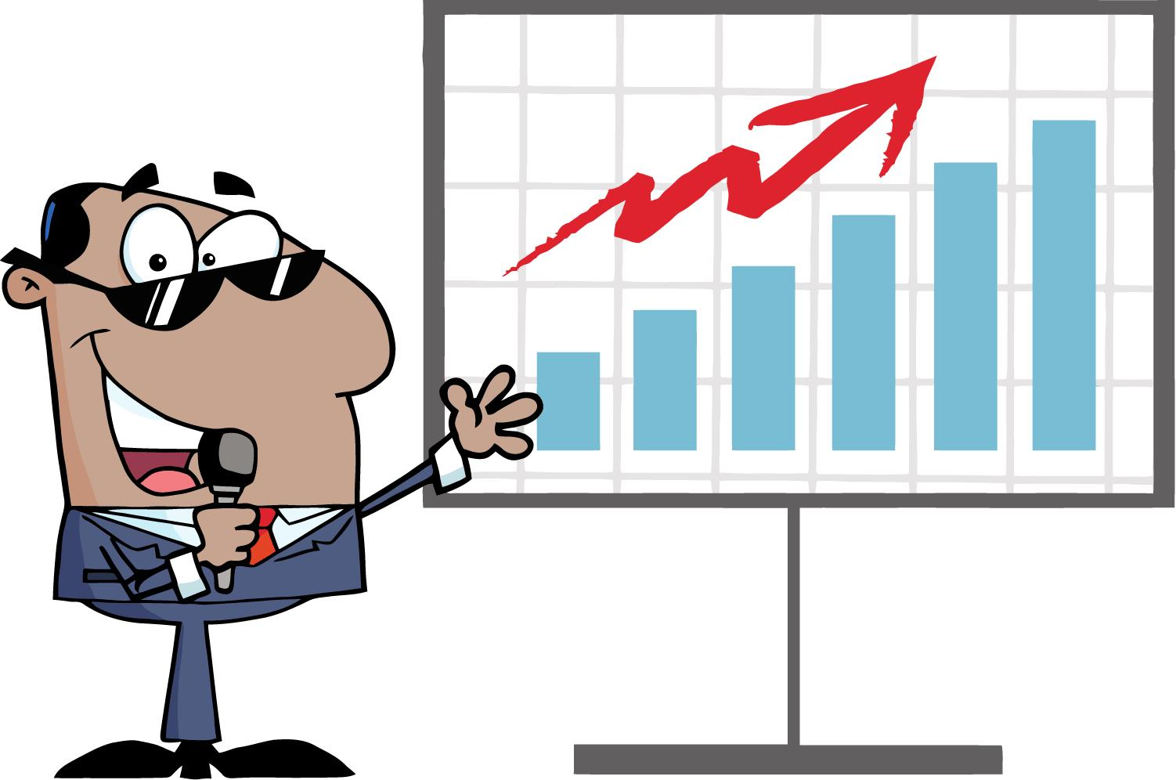
Describe the results shown for rose bushes.
For rose bushes, increasing the concentration of fertilizer inhibits plant growth.

Slide 8
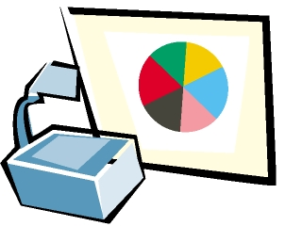
At what fertilizer concentration do oak seedlings stop improving?
At concentrations above 150 mg/L, oak seedling growth is inhibited.

Slide 9
What was the height of the tallest plant used in this experiment?
Corn grew to an average height of around 33 cm when the fertilizer concentration was 250 mg/L.

Slide 10
For which plant is this fertilizer least effective at higher concentrations?
Rose bushes.

Slide 11
Which plant shows the best growth when the fertilizer concentration is 100 mg/L?
Oak seedlings

Slide 12
Predict how tall corn plants might be when the fertilizer concentration is 75 mg/L.
The plants will be approximately 12 - 13 cm in height.

Slide 13
Consider the three types of plants used in this experiment. What reasons might explain why the results turned out as they did?
Possible answers: Plants that produce a large fruit (corn) need more fertilizer. Plants that produce a large woody stem (oak trees) grow best with moderate concentrations of fertilizer.

Slide 14
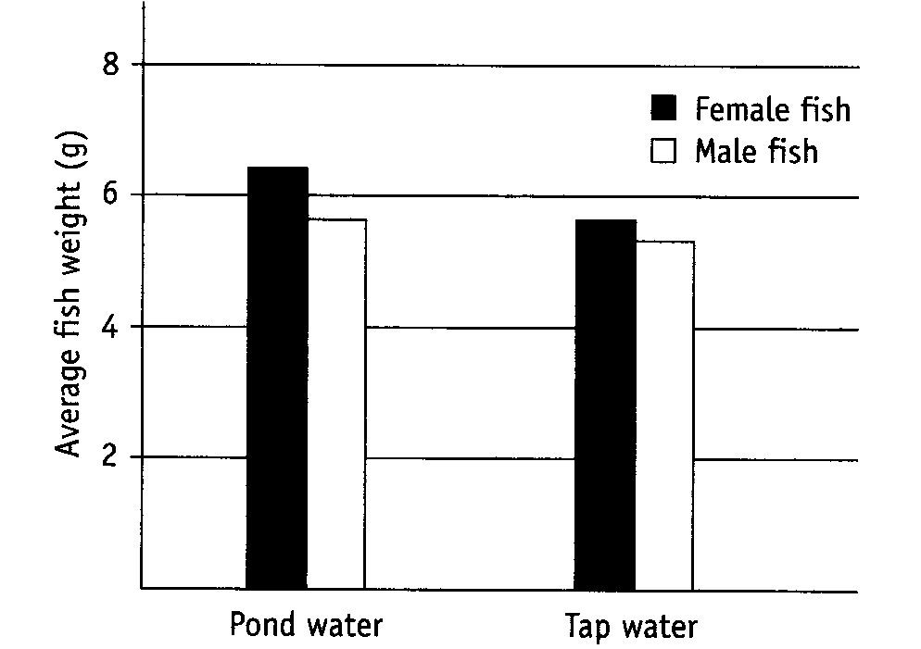
Study the bar graph to the right and answer the following questions:
Do fish grow to a larger weight in pond water or in tap water?
Pond water.
What is the average weight of female fish when grown in pond water?
Approximately 6.4 g.
Which grow larger, the males or the females?
Females

Slide 15
Study the bar graph to the right and answer the following questions:
What is the average weight of male fish when grown in tap water?
Approximately 5.5 grams.
Why do you suppose the fish grow the best in pond water?
Some possible answers might include: The tap water contains chlorine and fluorine, which might affect the growth of fish. Tap water does not contain all the various minerals and ions that might be found in pond water.

Slide 16
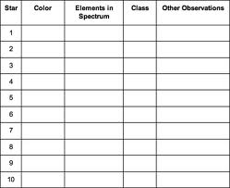
Making a Data Table
As scientists collect data, it must be recorded in an organized fashion.
Any time data is collected in an experiment, it is most often presented in a table.
The data table must have a title, rows, columns, and heads.
The title should be placed at the top and tells the observer what information is contained in the table.
At the top of each column should be a “head” that tells you what information is in the column.

Slide 17
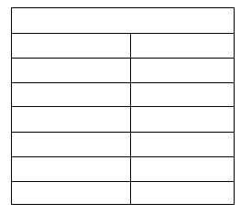
Example 1: Make a data table for the following information
The following data were collected for the growth of a plant.
On day 0, there was 0 growth. On day 1, there was 2.0 cm of growth. On day 2, there was 5.3 cm of growth. On day 3, there was 6.1 cm of growth. On day 4, there was 8.4 cm of growth. On day 5, there was 11 cm of growth.
The growth of a plant in centimeters
Day
Growth
0
1
2
3
4
5
0 cm
2.0 cm
5.3 cm
6.1 cm
8.4 cm
11 cm
In the top row, place the title of your data table.
In the next row, place the two column heads.
In the remaining rows, fill in the data.

Slide 18
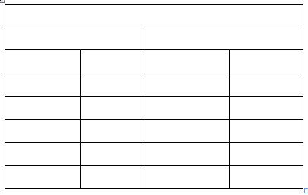
Example 2: Make a data table for the following information
The number of cricket chirps was recorded on two different nights at various temperatures (Celsius). On night 1, the following data was obtained: Temp 16, cricket chirps 33; Temp 18, cricket chirps 38; Temp 20, cricket chirps 42; Temp 22, cricket chirps 46; Temp 24, cricket chirps 50.
On night 2, the following data was obtained: Temp 16, cricket chirps 32; Temp 18, cricket chirps 36; Temp 20, cricket chirps 41; Temp 22, cricket chirps 43; Temp 24, cricket chirps 51.
In the top row, place the title of your data table.
The number of cricket chirps recorded at
different temperatures
Night 1 Night 2
In the next row, place the two column heads. Since data were collected on two different nights, you will need 4 columns.
Temp # Chirps
Temp # Chirps
16
18
20
22
24
33
38
42
46
50
16
18
20
22
24
32
36
41
43
51
In the remaining rows, fill in the data.

Slide 19
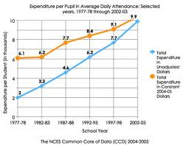
Making a Line Graph
Line graphs show data plotted as points that are connected by a line. Line graphs are often used to show change over time and can be used to compare two or more sets of data.
Before a line graph can be constructed, you must identify the two variables that will serve as x and y coordinates on the graph.
These are called the “independent variable” and the “dependent variable”.
An easy way to remember this is to ask yourself the questions:
“What did I know before I did the experiment?” (independent variable)
“What did I learn by doing the experiment?” (dependent variable)
The independent variable is the one being manipulated or changed during the experiment. It is always placed on the x-axis or horizontal axis.
The dependent variable is the observed result of the independent variable being changed. The dependent variable is always placed on the y-axis or vertical axis.

Slide 20
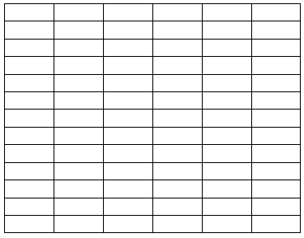
Using the grid below, make a line graph using the information in example 1 from above.
First determine which variable to place on the horizontal (x) axis and which variable to place on the vertical (y) axis.
The Growth of Plants in Centimeters
2 4 6 8 10 12
Label each axis
appropriately.
Growth (cm)
Scale each axis
appropriately.
Title your graph.
Plot the points on the
graph.
0 1 2 3 4 5 6
Time (days)

Slide 21
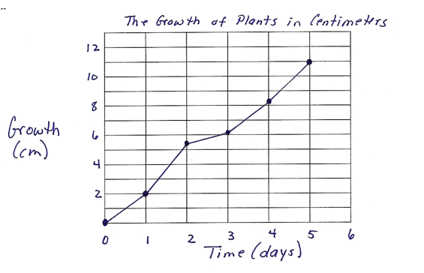
Your graph should look like this:

Slide 22
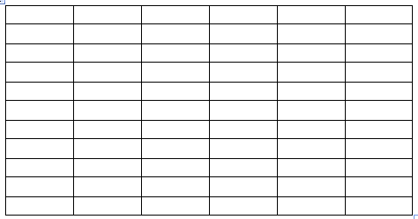
Using the grid below, make a line graph using the information in example 2 from above.
First determine which variable to place on the horizontal (x) axis and which variable to place on the vertical (y) axis.
Number of Cricket Chirps Recorded at Various Temperatures
Label each axis
appropriately.
# cricket chirps
10 20 30 40 50
Scale each axis
appropriately.
Title your graph.
Plot the points on the
graph.
Since this graph will have two different lines, be sure to label each line.
16 18 20 22 24
Temp (°C)

Slide 23
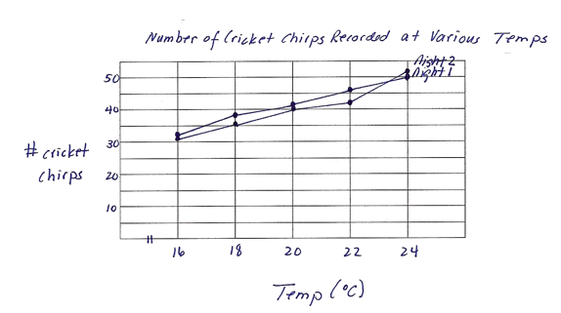
Your graph should look like this

Slide 24
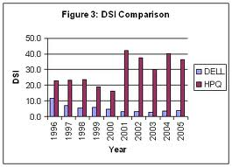
Making a Bar Graph
Bar graphs are useful for showing comparisons of data collected by counting.
A bar graph has two axes, a horizontal axis and a vertical axis. Generally the horizontal axis is labeled and the vertical axis is divided. The data are not related so the bars do not touch.

Slide 25
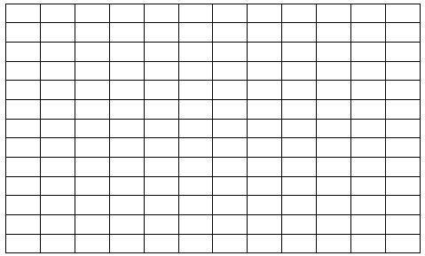
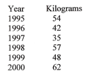
In the space below, make a bar graph of the following information.
In an orchard the following kilograms of peaches were picked during a 6 year period.
Peaches Picked in an Orchard
10 20 30 40 50 60
Kilograms of Peaches
Determine which variable to place on each axis. Label each axis.
1995
1996
1997
1998
1999
2000
Draw bars showing the appropriate amounts.
Title the graph.
Year

Slide 26
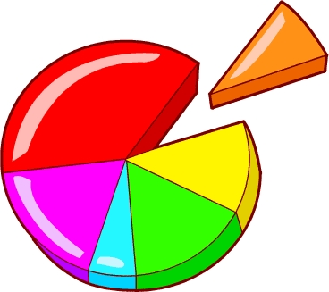
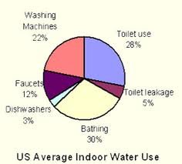
Making a Circle Graph
Circle graphs are used less often in science reporting, but they are often seen in newspapers and magazines.
A circle graph is a convenient way to show…
…the relative sizes of the parts that form an entire body of data.

Slide 27
Suppose that in a particular high school, the number of students taking a science class is as follows: 50% are taking biology, 30% are taking chemistry, 10% are taking physics and 10% are taking some other type of science class. Use the circle below to represent this data in pictorial form.
Chemistry
30%
Biology
50%
Physics
10%
Other
10%

Slide 28
Analysis
Questions
Under what circumstance would each of the following types of graphs be best used?
Line Graph:
Line graphs are often used to show change over time and can be used to compare two or more sets of data.
Bar Graph:
Bar graphs are useful for showing comparisons of data collected by counting.
Circle Graphs:
Circle graphs are best used to give the viewer an overall or broad picture view of smaller groups of data and how the smaller groups fit into the whole.

Slide 29
Analysis
Questions
2. How is a graph similar to a data table?
Both are methods of organizing information.
Does a steep curve on a line graph indicate a rapid or slow rate of change?
Rapid.

Slide 30
Analysis
Questions
You are conducting a photosynthesis experiment to determine how much oxygen is produced over a 24 hour period of time. You are measuring the oxygen production every hour for 24 hours.
What type of graph is best used to represent this data?
Line graph
When you construct a graph of your data, which variable will be placed along the x-axis?
Time
When you construct a graph of your data, which variable will be placed along the y-axis?
Oxygen production

Slide 31
Analysis
Questions
What is an advantage of using multiple lines on the same graph?
It allows you to show comparisons between different groups of data.

Slide 32

Created by Amy Brown – Science Stuff
Copyright © May 2013 Amy Brown (aka Science Stuff)
All rights reserved by author.
This document is for your classroom use only.
This document may not be electronically distributed or posted to a web site.

